Slide 1

GROUP
JIGGLYPUFF
Gamze Aksu – 171180005
Cansu Ayten – 171180010
Ceren Umay Özten - 181180060

Slide 2

MOTIVATION
Stroke is the third leading cause of death and disability worldwide.
Some special factors are important for the detection of stroke disease throughout people's lives.

Slide 3
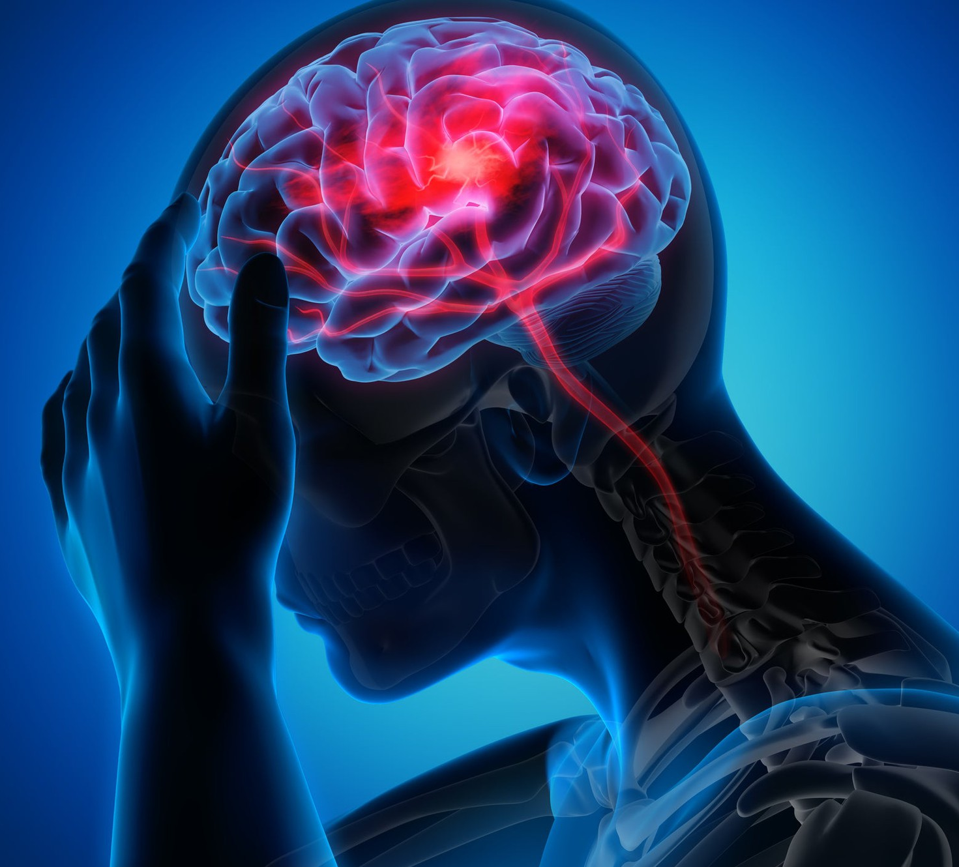
DATASET
This dataset includes 11 features. These are:
Id
Gender
Age
Hypertension
Heart Disease
Marriage Status
Work Type
Residence Type
Average Glucose Level
BMI (Body Mass Index)
Smoking Status

Slide 4

PREPROCESSING
There are 5110 records in the dataset.
id feature not included in the project
There are 201 null values in the BMI feature. These null values have been changed to be the median of the BMI feature.
Outlier values were found. Outlier values are also replaced with the median of the feature.

Slide 5

METHOD
ANN Model
Dense layers that have sequentially 64-32-16-1 number of neural nodes from input layer - hidden layer - output layer.
As the activation function, ‘‘relu" in the hidden layer and the ‘‘sigmoid’’ function in the output layer were used.
‘‘Binary cross entropy" function was used as loss function.
Model is trained 50 epochs.

Slide 6

EXPERIMENTS - 1
The learning rate values, epoch and initial weights were changed.
Learning rate values changed to 0.1, 0.01, 0.001, and 0.0001.
Epoch values were tried as 50 and 100.
The initial values ​​of the weights are chosen randomly over the normal distribution, and secondly, they are all zero.
Then the weights were assigned as initial values.
Outcomes were observed at the end of these experiments. The best output is obtained in 50 epochs trained model with zero weights and a learning rate of 0.1.

Slide 7
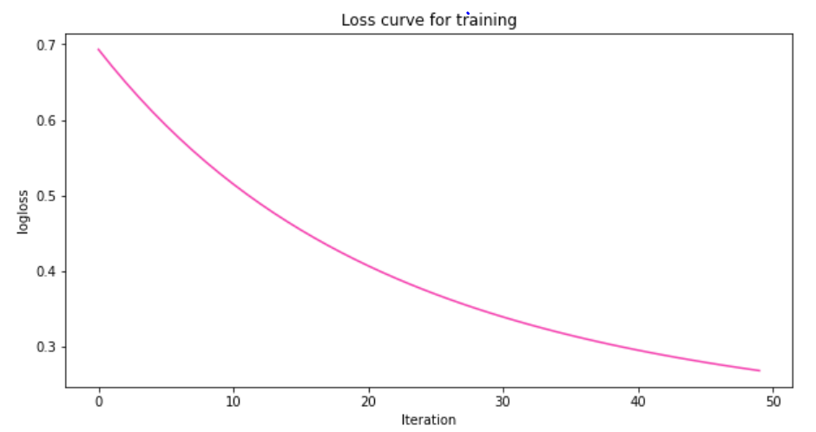
RESULT - 1
0.94 accuracy with 50 epochs and learning rate of 0.1

Slide 8

INTERPRETABILITY
Interpretability is used to get the models created with Deep Learning out of the Black Box state. Thus, the model's decision-making style can be easily understood by associating it with its outputs.
A local method is used to understand the decision-making process for a single instance of the model.
A global method is used to understand the decision-making process according to the general structure of the model.

Slide 9


INTERPRETABILITY
SHAP
Contains a local and a global method.
With the SHAP Values, interpretability is enhanced by associating the model and data with outputs.

Slide 10

EXPERIMENTS - 2
It is seen that the age feature contributes the most to the model in the interpretability summary plot. Age feature affects the model a lot as it has much more contribution than others.
The age feature was removed and the effect of other features on the model was examined.
After removing the age feature, it is seen that it is the average glucose level feature that contributes the most to the model.

Slide 11
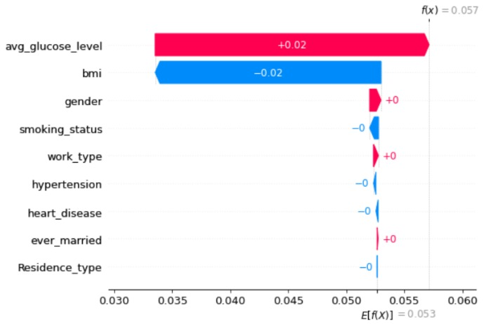
RESULT - 2

Slide 12
EXPERIMENTS - 3
It is seen that the feature with the least contribution in the summary plot of the model is the heart disease feature.
The heart disease feature was removed and the effect of other features on the model was observed.
After removing the heart disease feature, the age feature again contributes by far the most.

Slide 13
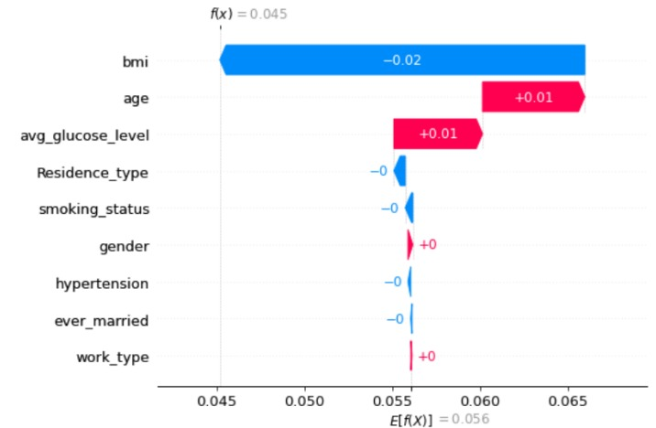
RESULT - 3

Slide 14



